Slide 1
Unit 5 Memory Management:
Memory Management requirements, Memory Partitioning, Paging, Segmentation, Address translation, Placement Strategies: First Fit, Best Fit, Next Fit and Worst Fit. Virtual Memory, VM with Paging, VM with Segmentation, Page Replacement Policies: FIFO, LRU, Optimal

Slide 2
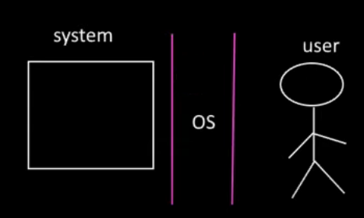
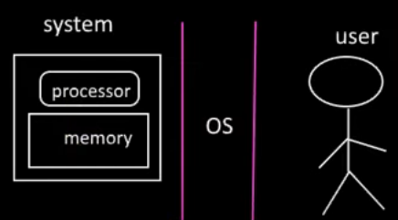
Memory management
OS is an interface between hardware and User.
Goal of OS it to make communication efficient between system and user.
System is consist of processor and memory.

Slide 3
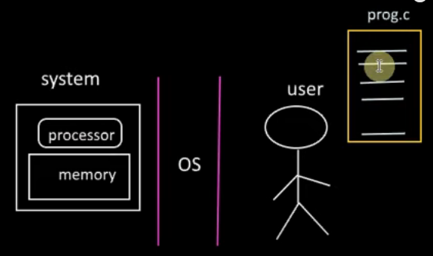
Memory management
Now , user want to solve a problem ,so he has written a program
Now task of OS to make hardware to execute the program and provide the solution to the user.
Data and input should be kept in memory for execution.

Slide 4
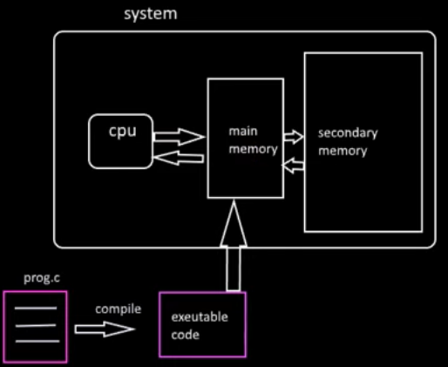
How the memory organized?

Slide 5
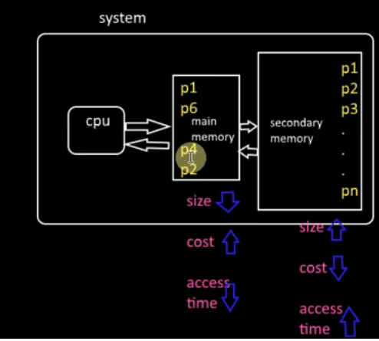

Slide 6
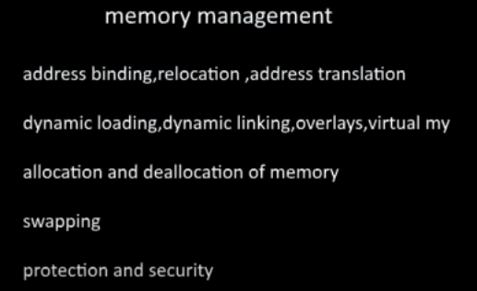

Slide 7
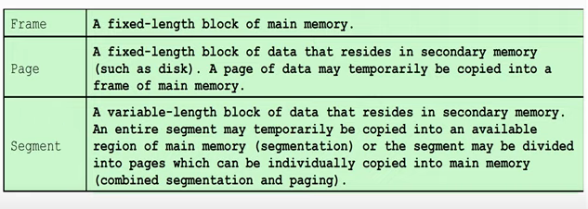
memory management terms:

Slide 8
Requirements of Memory Management System
Memory management keeps track of the status of each memory location, whether it is allocated or free.
It allocates the memory dynamically to the programs at their request and frees it for reuse when it is no longer needed.
Memory management meant to satisfy some requirements such as :
Relocation
Protection
Sharing
Logical organization
Physical organization

Slide 9
Relocation in Memory Management
Relocation – In a multiprogramming system, multiple processes (programs) can reside in main memory (RAM) simultaneously, memory is shared among these processes.
Since several processes can be running at the same time, the memory available for any new program is not fixed.
processes can be loaded and unloaded from memory dynamically,
For example, if you have several programs running, and one of them terminates, it frees up some memory space
And return back to secondary memory

Slide 10
Relocation in Memory Management
And again it come for execution from disk to main memory (swapped out to disk memory), it may not return to its original location in main memory
because that space could be occupied by another process.
As a result, the operating system may need to relocate the program to a different area of memory upon swapping it back in.
After loading of the program into main memory, the processor and the operating system must be able to translate logical addresses into physical addresses.
Example: When a process is compiled, it might assume that it starts at address 0. However, during execution, the OS might load it into a different memory segment. The OS uses a relocation register to keep track of where the process is actually loaded and adjusts addresses in the process accordingly. For instance, if the process is loaded starting at address 1000, every address reference by the process is adjusted by adding 1000.

Slide 11
Protection in Memory Management
When multiple programs run at the same time, there's a risk that one program could accidentally write to the memory space of another program. To prevent this unwanted interference, each process needs protection.
Protection Against Interference:
Each process should have its own separate memory space. If one process tries to write to another process's memory, it could corrupt data or crash the program.
Dynamic Address Calculation:
Since it’s impossible to predict where a program will be in memory when it runs, the exact memory address can’t be checked at compile time.
Many programming languages support dynamic address calculation at runtime, meaning the addresses are determined while the program is executing.

Slide 12
Sharing in Memory Management
A protection mechanism in memory management allows multiple processes to access the same part of main memory safely.
Instead of each process having its own copy of a program or file, it’s more efficient to let them share a single copy.
This can save memory and resources.

Slide 13
Logical Organization in Memory
Main memory is organized as a linear or one-dimensional address space,
means it is made up of a sequence of bytes or words.
Programs can be broken down into smaller parts called modules.
These modules can have different types:
Unmodifiable Modules:
These can only be read or executed but not changed. Examples include library functions or system code.
Modifiable Modules:
These contain data that can be changed during program execution, like variables in a user application.

Slide 14
Physical Organization in Memory
Computer memory is structured into two main levels: main memory and secondary memory.
Main Memory:
This is the fast and expensive type of memory where currently used programs and data are stored.
It is volatile, meaning that it loses its data when the power is turned off.
Secondary Memory:
This is slower and cheaper memory used for long-term storage of data and programs, such as hard drives or SSDs.
It retains data even when the computer is turned off.

Slide 15
Physical Organization in Memory
Flow of Information
The main concern in a computer system is how information flows between main memory and secondary memory. Programmers face two challenges:
Overlaying:
When there isn’t enough main memory available for a program and its data, programmers can use a technique called overlaying. This means assigning different modules to the same memory space to make better use of limited memory.
However, this can be complicated and time-consuming because programmers have to carefully manage which modules are in memory at any given time.
Example :The text editor has three main modules: User Interface (UI), Text Processing, and File Management.
When a user opens the text editor, only the User Interface module is loaded into memory.
Once the user types some text and needs to save it, the program can swap out the User Interface module and load the File Management module into the same memory space.
After saving the file, the program can then swap out the File Management module and load the Text Processing module to allow the user to edit the text further.

Slide 16
Memory partitioning
There are two Memory Management techniques:
Contiguous
Non-Contiguous
In Contiguous Technique, executing process must be loaded entirely in the main memory.
Contiguous Technique can be divided into:
Fixed (or static) partitioning
Variable (or dynamic) partitioning

Slide 17
Memory partitioning
Memory partitioning in an operating system (OS) is a technique used to divide the system's main memory (RAM) into different sections or partitions.
It is employed to allocate memory to various processes or programs, ensuring efficient use of system resources.
types of memory partitioning methods, :
1)Fixed (Static) Partitioning
2) variable(dynamic ) Partitioning

Slide 18
Fixed (Static) Partitioning:
is a memory allocation technique
used in operating systems to divide the physical memory into fixed-size partitions or regions,
each assigned to a specific process .
Each partition holds one process, but if the process is smaller than the partition, the remaining space is wasted (internal fragmentation).
This method is easy to set up, but it’s not very efficient
because some memory may remain unused if the partition sizes don’t match the process sizes.

Slide 19
Fixed (Static) Partitioning:
Fixed partitioning is a useful memory allocation technique in situations where the number of processes is fixed,
and the memory requirements for each process are known in advance.
Fixed partitioning is here
No. of partitions are fixed .
Size of each partition may or may not be same .
Contiguous allocation so spanning not allowed
Spanning means put a process across multiple locations in a part.
For partitioning there are two possibilities:
a). Equal size partitioning
b). Unequal size Partition

Slide 20
RAM
OS
OS
1) P1=4MB
0
P1
4MB
0
8MB
1
8MB
1
8MB
2
8MB
2
8MB
3
16MB
3
8MB
unequal size partitioning
Equal size partitioning

Slide 21
RAM
OS
OS
Now consider P1= 2 MB
P2 = 7MB
P3= 6MB
P4= 32 MB ..cant allocate
P5=14 MB
P6 = 7MB …cant allocate
P1 = 6MB
P2=9 MB
P1
0
4MB
0
P1
2 MB is waste
8MB
2 MB is waste
2 MB is waste
2 MB is waste
2 MB is waste
1
P2
8MB
1
1 MB is waste
8MB
2
P3
8MB
2
2 MB is waste
8MB
P4
3
16MB
3
8MB
2 MB is waste
unequal size partitioning
Equal size partitioning

Slide 22
Disadvantages for unequal size partitioning
Internal Fragmentation
Limitation in process size
Can put limited processes in memory because of fixed partitioning , so it is limitation in degree of multiprogramming
External fragmentation : External fragmentation is when free memory is scattered in small pieces, making it hard to fit large programs even though there’s enough total space.

Slide 23
Disadvantages for equal size partitioning
Internal Fragmentation
Limitation in process size
Can put limited processes in memory because of fixed partitioning , so it is limitation in degree of multiprogramming
External fragmentation : External fragmentation is when free memory is scattered in small pieces, making it hard to fit large programs even though there’s enough total space.
Process size limitation

Slide 24
Variable/Dynamic Partitioning:
Partitions are created based on the size of the process when it is loaded into memory.
More flexible compared to fixed partitioning, as it reduces internal fragmentation.
Initially, RAM is empty and partitions are made during the run-time according to the process’s need instead of partitioning during system configuration.
The size of the partition will be equal to the incoming process.
The partition size varies according to the need of the process so that internal fragmentation can be avoided to ensure efficient utilization of RAM.

Slide 25
RAM
OS
P1=2MB
P2=4MB
P3=7MB
P1
2MB
P2
4MB
P3
7MB
Variable /dynamic partitioning

Slide 26
RAM
OS
P1=2MB
P2=4MB
P3=7MB
P4=4MB
P5=8MB
P1
2MB
P2
4MB
P3
7MB
P4
4MB
P5
8MB
Variable /dynamic partitioning

Slide 27
Variable/Dynamic Partitioning:
Advantages of Variable(Dynamic) Partitioning
No Internal Fragmentation:
In variable Partitioning, space in the main memory is allocated strictly according to the need of the process,
hence there is no case of internal fragmentation There will be no unused space left in the partition.
No restriction on the Degree of Multiprogramming:
More processes can be accommodated due to the absence of internal fragmentation.
A process can be loaded until the memory is empty.
No Limitation on the Size of the Process:
In Fixed partitioning, the process with a size greater than the size of the largest partition could not be loaded and the process can not be divided as it is invalid in the contiguous allocation technique.
Here ,In variable partitioning, the process size can’t be restricted since the partition size is decided according to the process size.

Slide 28
RAM
OS
P1=2MB
P2=4MB
P3=7MB
P4=4MB
P5=8MB
Now consider P2 has finished/ blocked so 4MB is available (hole)
P4 also leaves so 4MB free.
New P6 =8MB but cant allocate
P1
2MB
4MB
P3
7MB
4MB
P5
8MB
Variable /dynamic partitioning

Slide 29
Variable/Dynamic Partitioning:
Disadvantages of Variable(Dynamic) Partitioning
Difficult Implementation:
Implementing variable Partitioning is difficult as compared to Fixed Partitioning as it involves the allocation of memory during run-time rather than during system configuration.
External Fragmentation:
There will be external fragmentation
External fragmentation is when free memory is scattered in small pieces, making it hard to fit large programs even though there’s enough total space.

Slide 30
Paging in OS

Slide 31
Paging in OS
Paging is a memory management technique used in modern operating systems to manage and allocate physical memory.
It is non contiguous memory allocation.
The basic purpose of paging is to separate each process into pages.
The process’s logical address space is also divided into fixed-size blocks called pages,
In paging, the physical memory is divided into fixed-size blocks called page frames,
Size of page and frame must be same.
When CPU needs to execute the process ,the process has to loaded in to main memory.

Slide 32
Paging in OS
The process of retrieving processes in the form of pages from the secondary storage into the main memory is known as paging.
then placed to pages into the frames.
The conversion of LA to PA is done by CPU ,using MMU(Memory management Unit)
This address mapping is maintain by a data structure known as a page table.
MMU refer the page table while conversion.

Slide 33
Terminologies Associated with Memory Control
Logical Address or Virtual Address:
is the address generated by the CPU when a program is running.
It is the address a program uses to access memory, but it doesn't correspond directly to an actual location in physical memory (RAM).
Instead, the operating system maps this logical address to a physical address in memory.
Physical Address: Actual location in physical RAM.
The program doesn’t know or care about the physical address; it only uses the logical address, and the operating system handles the translation in the background.

Slide 34
Terminologies Associated with Memory Control
Logical Address Space or Virtual Address Space:
This is the set of all logical addresses generated via a software program.
Physical Address Space: This is the set of all physical addresses.

Slide 35
How paging works:
When a process is executing in a computer system, the flow of address translation between logical addresses and physical addresses involves both the CPU and the Operating System (OS), particularly through the paging mechanism. Here’s a step-by-step breakdown of the process:
Process Execution Starts:
When a program is loaded into memory, it is assigned a logical address space divided into fixed-size blocks called pages (e.g., 4KB each). The OS is responsible for managing these pages.
CPU Generates Logical Addresses:
As the CPU executes instructions in the program, it generates logical addresses to access data and instructions.
For example, if the CPU needs to read data from a variable stored at logical address 0x0000, it will generate that logical address.
Address Translation Initiation:
The logical address generated by the CPU consists of two parts:
Page Number: Identifies which page the address belongs to.
Offset: Identifies the specific location within that page.

Slide 36
OS Uses the Page Table:
The CPU uses a Memory Management Unit (MMU) to translate the logical address to a physical address. The MMU consults the page table maintained by the OS for the currently executing process.
The page table maps each logical page to a corresponding physical frame in RAM.
For instance, if logical address 0x0000 corresponds to page 0 with an offset of 0x000, the MMU looks up page 0 in the page table to find the corresponding physical frame.
Mapping from Logical to Physical Address:
The MMU finds the frame number associated with page 0 in the page table.
It combines the frame number with the offset from the logical address to create a physical address. For example:
If page 0 maps to frame 3 in physical memory, and the offset is 0x003, the physical address becomes: Physical Address=Base Address of Frame 3 + Offset

Slide 37
Accessing Physical Memory:
The CPU then accesses the physical memory using the physical address computed by the MMU.
The data at that physical address is retrieved and returned to the CPU for processing.
Handling Page Faults (if necessary):
If the page table indicates that the required page is not currently in physical memory (this is known as a page fault), the OS must take over:
The OS will identify the required page on disk (in secondary storage).
It may swap another page out of physical memory to make room for the new page.
The OS loads the required page into RAM and updates the page table accordingly.
The CPU can then retry the memory access once the page is available in physical memory.

Slide 38
Page fault
A page fault occurs when a program tries to access a page that is not currently in physical memory (RAM). This typically happens in systems that use virtual memory, where parts of a program are stored on the disk and only loaded into memory when needed.
How a Page Fault Works:
Program Accesses a Page:
The CPU generates a logical address (or virtual address) to access a page of memory.
MMU Tries to Map the Page:
The Memory Management Unit (MMU) checks whether the required page is in physical memory by looking at the page table.
Page Not in Memory (Page Fault):
If the page is not in RAM (i.e., it is on disk or has not been loaded into memory yet), the MMU triggers a page fault interrupt, notifying the operating system that the page is missing.

Slide 39
Page fault
Operating System Handles the Page Fault:
The operating system takes control and locates the page in secondary storage (e.g., the hard disk or SSD).
If necessary, the OS may free up space in physical memory by swapping out another page (if RAM is full).
Page Loaded into Memory:
The operating system copies the missing page from secondary storage into RAM.
Page Table Update:
The page table is updated to reflect that the page is now in memory, mapping the logical address to the correct physical frame.
Process Resumes:
The CPU is allowed to resume execution, and the program can access the required page as if it had been in memory all along.

Slide 40
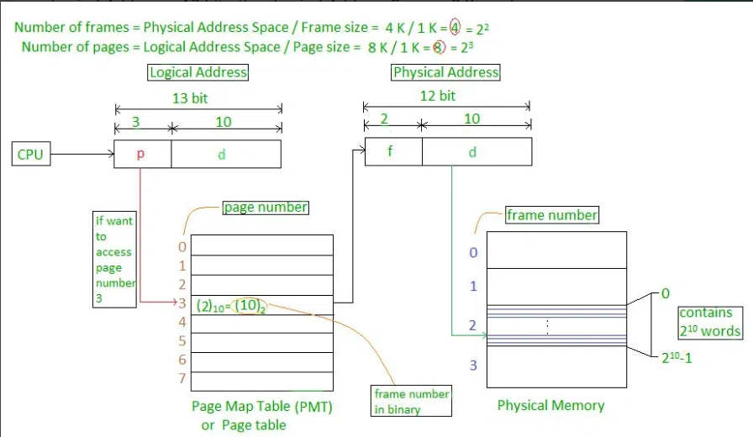
Fig. Translation

Slide 41
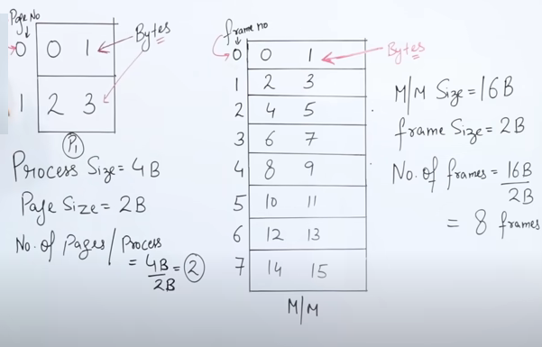

Slide 42
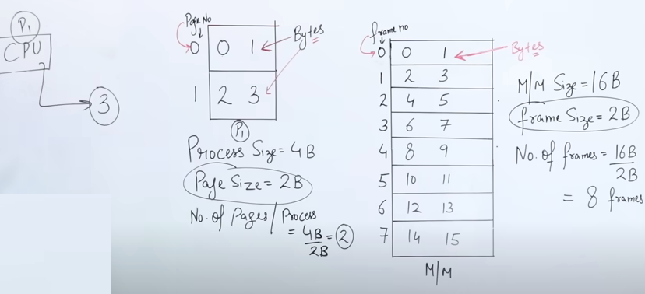
CPU want s byte no.3 ,but this 3 is in main memory

Slide 43
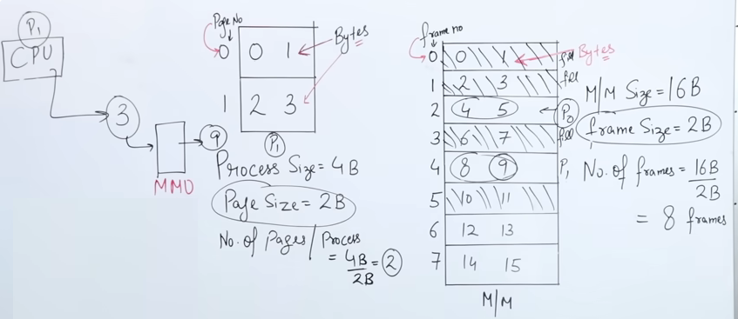
Now consider the main memory is like 0,1,and 3rd frames are already full ,so we save the page0 and page1 at 2nd frame and 4th frame in main memory. Here CPU wants 3rd byte ,but it in main memory at different place ,so we need mapping here,3rd is present at 9th location in our example, so here page table is used for mapping.

Slide 44
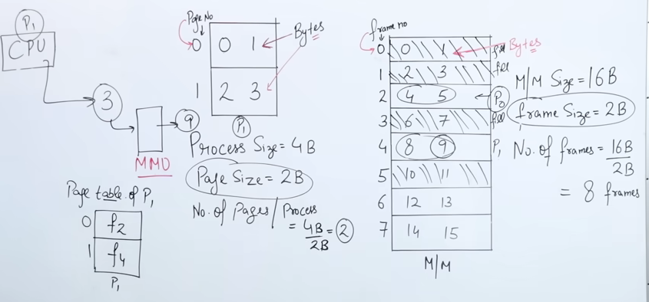

Slide 45
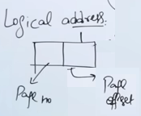
CPU generates the Logical address, here offset shows the size ,so page size is 2 ,to represent 2 we need 1 bit 2¹ = 2,so offset is 1.

Slide 46
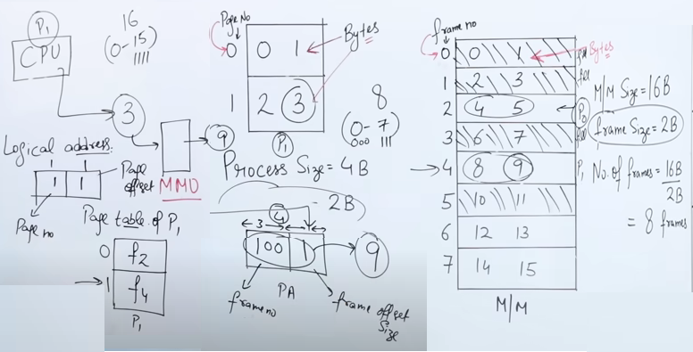
To generates the physical address, we need frame no +offset to represent 16 byte i.e mem. size we need 4 bit , 2⁴ = 16,so PA size is also 4. Now total Frame no. are 7 ,so here we need 3 bit .and we want to search for Page 1 ,which is in frame 4 so its binary representation is 100 +1 =101=9

Slide 47
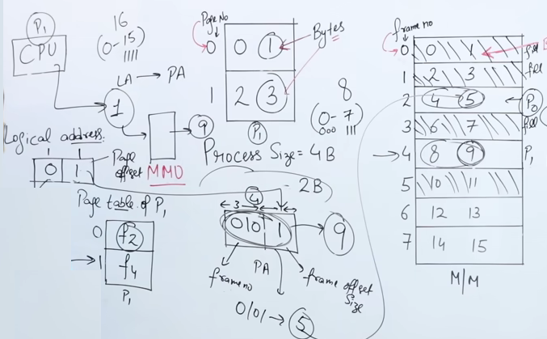
Now example ,CPU wants Byte 1

Slide 48
Paging
The Logical address, divided into
Page number(p)
Page offset(d): Number of bits required to represent a particular word in a page
Physical Address is divided into:
Frame number(f)
Frame offset : Number of bits required to represent a particular word in a frame

Slide 49
What is Memory Management Unit (MMU)?
A memory management unit (MMU) is a technique used to convert logical address to physical address.
Logical address is the address generated by CPU for each page and
physical address is the real address of the frame where page is going to be stored.
Whenever a page has to be accessed by CPU using the logical address, it requires physical address for accessing the page.

Slide 50
Segmentation
in Operating System

Slide 51
Segmentation
A process is divided into Segments.
a program is divided into the chunks/blocks that are called segments.
not necessarily all of the exact sizes
Segmentation gives the user’s view of the process which paging does not provide.
Here the user’s view is mapped to physical memory.

Slide 52
Types of Segmentation
Virtual Memory Segmentation:
Each process is divided into a number of segments, but the segmentation is not done all at once.
This segmentation may or may not take place at the run time of the program.
Simple Segmentation:
Each process is divided into a number of segments,
all of which are loaded into memory at run time, though not necessarily contiguously.

Slide 53
What is Segment Table?
A table stores the information about all such segments is called Segment Table. and it contains info about :
Base Address: It contains the starting physical address where the segments reside in memory.
Segment Limit: Also known as segment offset. It specifies the length of the segment.

Slide 54
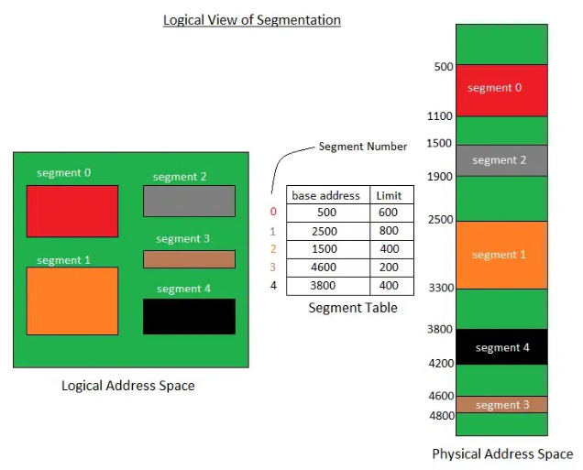
Fig: Segmentation

Slide 55
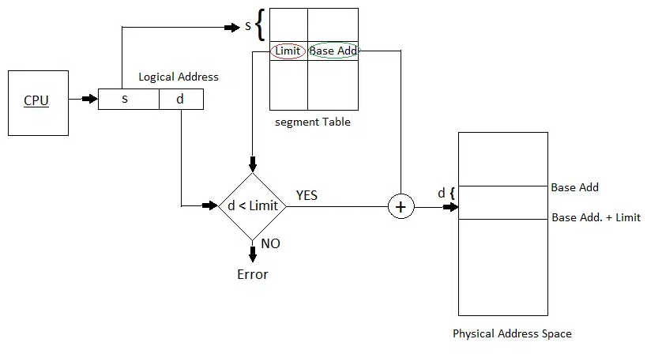
Fig: Translation
Segment no

Slide 56
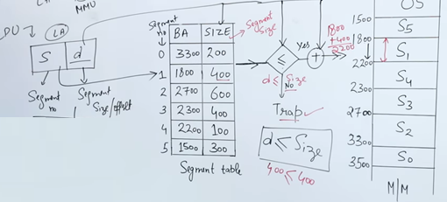

Slide 57
Advantages of Segmentation in Operating System
Reduced Internal Fragmentation:
Segmentation can reduce internal fragmentation compared to fixed-size paging, as segments can be sized according to the actual needs of a process.
Segment Table consumes less space in comparison to Page table in paging.
As a complete module is loaded all at once, segmentation improves CPU utilization.
The user specifies the segment size, whereas, in paging, the hardware determines the page size.
Flexibility: Segments can be of variable size
Sharing: Segmentation allows for sharing of memory segments between processes.
Protection: Segmentation provides a level of protection between segments,

Slide 58
Disadvantages of Segmentation in Operating System
External Fragmentation :
As processes are loaded and removed from memory, the free memory space is broken into little pieces, causing external fragmentation
Due to fragmentation This can lead to wasted memory and decreased performance.
Complexity: Segmentation can be more complex to implement and manage than paging

Slide 59
Partition allocation Strategies:
The goal of partition allocation strategies is to find an appropriate place in memory for each process in a way that maximizes efficiency and minimizes fragmentation.
A partition allocation method is considered better if it avoids internal fragmentation.
When it is time to load a process into the main memory and if there is more than one free block of memory of sufficient size then the OS decides which free block to allocate.
There are different Placement Algorithm:
Contiguous Memory Allocation:
First Fit,
Best Fit,
Next Fit and
Worst Fit.

Slide 60
First Fit:
In the first fit, the partition is allocated which is the first sufficient block from the top of Main Memory.
It scans memory from the beginning and chooses the first available block that is large enough.
Thus it allocates the first hole(free available space) that is large enough.

Slide 61
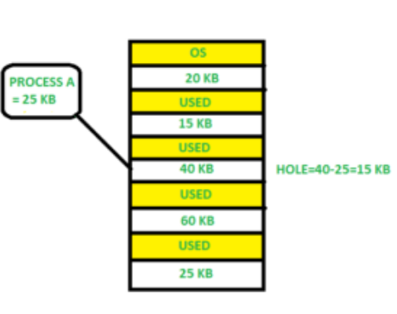
First Fit:

Slide 62
Next Fit:
The Next Fit strategy is similar to First Fit,
but instead of starting from the beginning of memory every time, it starts searching from where the last allocation was made.
This can reduce search time in some cases.

Slide 63
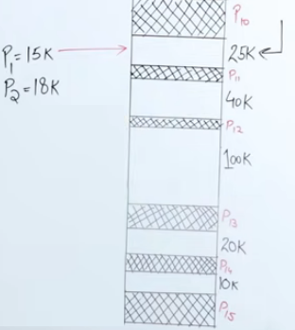
Next Fit:
PTR
15K
18K

Slide 64
Best Fit :
In the Best Fit strategy, the system searches the entire memory and selects the smallest available block that is large enough to accommodate the process.
The goal is to minimize wasted space.

Slide 65
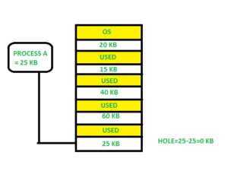
Best Fit :

Slide 66
Worst Fit:
The Worst Fit strategy allocates the largest available block of memory to a process.
The idea is to leave large unused blocks to avoid fragmentation.
It is opposite to the best-fit algorithm.
It searches the entire list of holes to find the largest hole and allocate it to process.

Slide 67
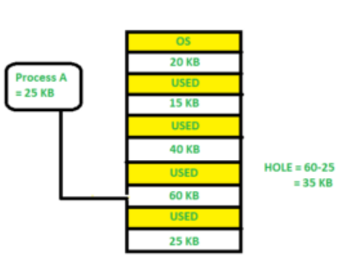
Worst Fit:

Slide 68
Comparison of Partition Allocation Methods:
Sl.No. | Partition Allocation Method | Advantages | Disadvantages
1. | Fixed Partition | Simple, easy to use, no complex algorithms needed | Memory waste, inefficient use of memory resources
2. | Dynamic Partition | Flexible, more efficient, partitions allocated as required | Requires complex algorithms for memory allocation
3. | Best-fit Allocation | Minimizes memory waste, allocates smallest suitable partition | More computational overhead to find smallest split
4. | Worst-fit Allocation | Ensures larger processes have sufficient memory | May result in substantial memory waste
5. | First-fit Allocation | Quick, efficient, less computational work | Risk of memory fragmentation

Slide 69
Exercise:
Consider the requests from processes in given order 300K, 25K, 125K, and 50K. Let there be two blocks of memory available of size 150K followed by a block size 350K.
Which of the following partition allocation schemes can satisfy the above requests? A) Best fit but not first fit. B) First fit but not best fit. C) Both First fit & Best fit. D) neither first fit nor best fit.

Slide 70
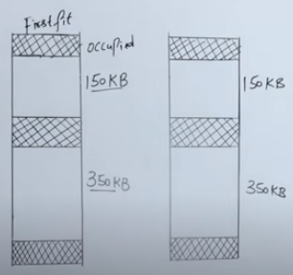
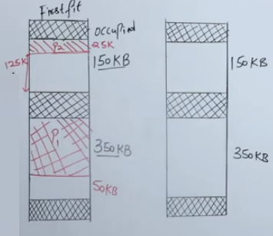
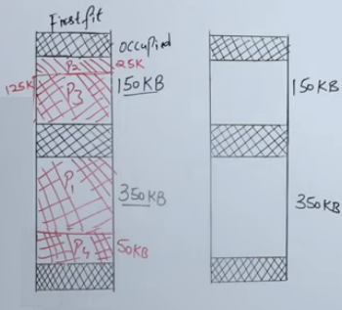
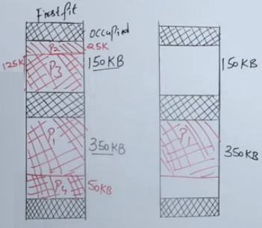
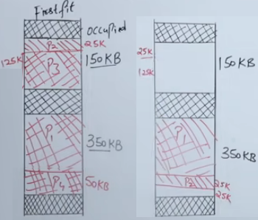
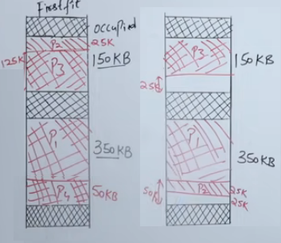
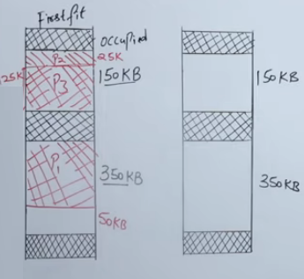
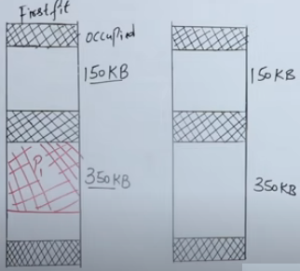
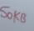
Answer given order 300K, 25K, 125K, and 50K Consider Processes P1,P2,P3& P4
Best Fit
Best Fit
Now in Best fit ,for 50k external fragmentation will be there ,Because it is contiguous memory allocation so can not allocate available memory in parts
Best Fit

Slide 71
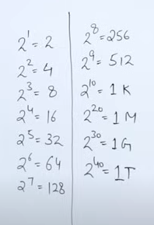
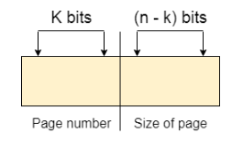
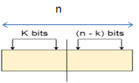
Exercise
Consider a system which has LA=7bits ,PA=6bits ,page size = 8words,then calculate no. of pages and no. of frames.
Answer:
LA =
Page size =8 words ,to represent 8 we need
2³ = 8
To represent page size we need 3 bits.
n
PA
Frame number
Size of frame
6
7
2⁴ = 16 pages
3
3
4
3
2³ = 8Frames

Slide 72
Physical and Logical Address Space
Physical Address Space = Size of the Main Memory If, physical address space = 64 KB = 2 ^ 6 KB = 2 ^ 6 X 2 ^ 10 Bytes = 2 ^ 16 bytes Let us consider, word size = 8 Bytes = 2 ^ 3 Bytes Hence, words in Physical address space = (2 ^ 16) / (2 ^ 3) = 2 ^ 13 Words Therefore, Physical Address = 13 bits In General, If, Physical Address Space = N Words then, Physical Address = log₂ N

Slide 73
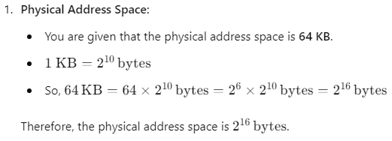
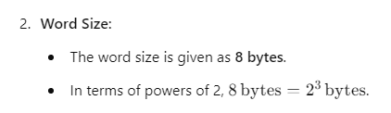
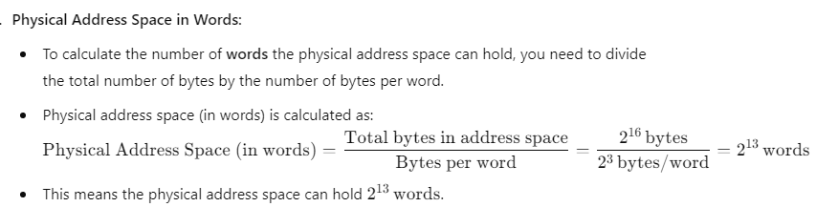
Physical and Logical Address Space

Slide 74
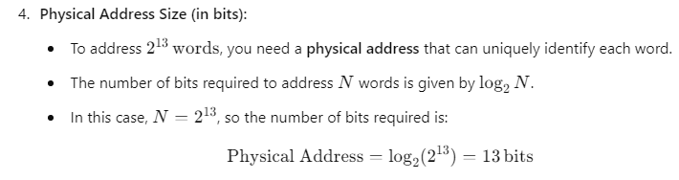
Physical and Logical Address Space

Slide 75
Physical and Logical Address Space
Logical Address Space = 128 MB = (2 ^ 7 X 2 ^ 20) Bytes = 2 ^ 27 Bytes Word size = 4 Bytes = 2 ^ 2 Bytes words in Logical Address Space (in words) = (2 ^ 27) / (2 ^ 2) = 2 ^ 25 Words Logical Address = 25 Bits

Slide 76
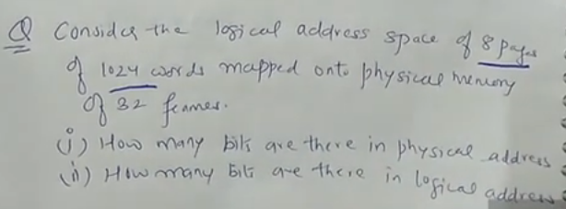
Question

Slide 77
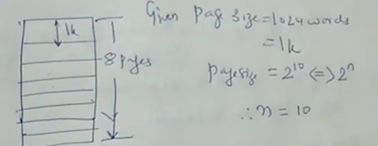
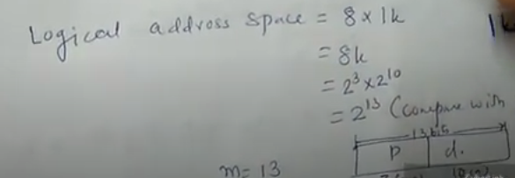
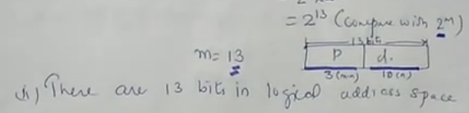

Slide 78
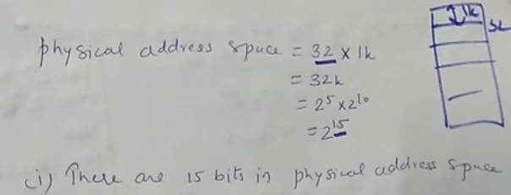

Slide 79
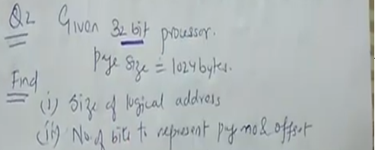

Slide 80
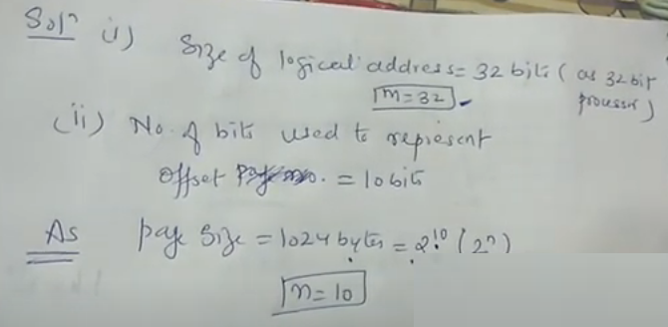

Slide 81
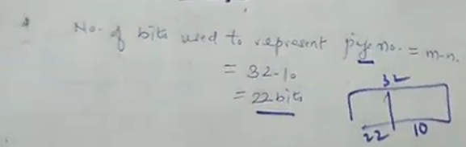

Slide 82
Virtual Memory
Virtual Memory is a storage scheme that provides user an illusion of having a very big main memory.
This is done by treating a part of secondary memory as the main memory. And this extra memory is called as virtual memory.
Virtual memory is a part of hard disk but it is set up to emulate the RAM.
In this scheme, User can load the bigger size processes than the available main memory by having the illusion that the memory is available to load the process.
Instead of loading one big process in the main memory, the Operating System loads the different parts of more than one process in the main memory.
By doing this, the degree of multiprogramming will be increased and therefore, the CPU utilization will also be increased.

Slide 83
How Virtual Memory Works?
In this scheme, whenever some pages needs to be loaded in the main memory for the execution and the memory is not available for those many pages,
then in that case, instead of stopping the pages from entering in the main memory,
the OS search for the RAM area that are least used in the recent times or that are not referenced and copy that into the secondary memory to make the space for the new pages in the main memory.
Since all this procedure happens automatically, therefore it makes the computer feel like it is having the unlimited RAM.

Slide 84
Demand Paging
Demand Paging is a popular method of virtual memory management.
In demand paging, the pages of a process which are least used, get stored in the secondary memory.
A page is copied to the main memory when its demand is made or page fault occurs.
There are various page replacement algorithms which are used to determine the pages which will be replaced.

Slide 85
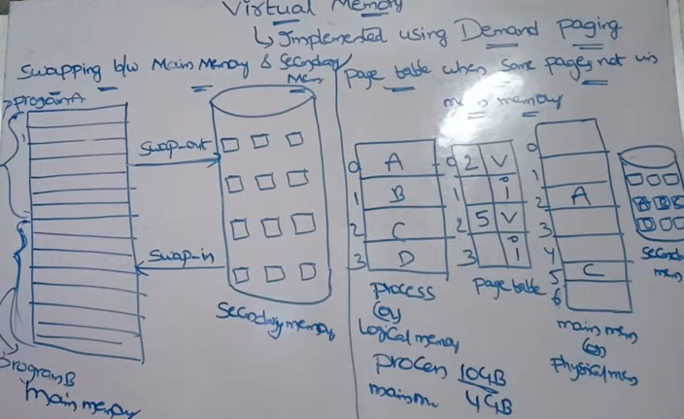
Demand Paging
V=valid(present bit) ,i=invalid(absent bit)

Slide 86
Page Fault Terminology
Page Hit
When the CPU attempts to obtain a needed page from main memory and the page exists in main memory (RAM), it is referred to as a "PAGE HIT".
2. Page Miss
If the needed page has not existed in the main memory (RAM), it is known as "PAGE MISS".

Slide 87
Page Fault Terminology
3. Page Fault Time
The time it takes to get a page from secondary memory and recover it from the main memory after loading the required page is known as "PAGE FAULT TIME".
4. Page Fault Delay
The rate at which threads locate page faults in memory is referred to as the "PAGE FAULT RATE". The page fault rate is measured per second.
5. Hard Page Fault
If a required page exists in the hard disk's page file, it is referred to as a "HARD PAGE FAULT".
6. Soft Page Fault
If a required page is not located on the hard disk but is found somewhere else in memory, it is referred to as a "SOFT PAGE FAULT"

Slide 88
Page Fault Handling in VM
A page fault will happen if a program tries to access a piece of memory that does not exist in physical memory
The fault specifies the operating system to trace all data into virtual memory management
and then relocate it from secondary memory to its primary memory

Slide 89
Page Fault Handling in VM
A page fault trap occurs if the requested page is not loaded into memory.
The page fault primarily causes an exception, which is used to notify the operating system to retrieve the "pages" from virtual memory to continue operation.
Once all of the data has been placed into physical memory, the program resumes normal operation.
The Page fault process occurs in the background, and thus the user is unaware of it.

Slide 90
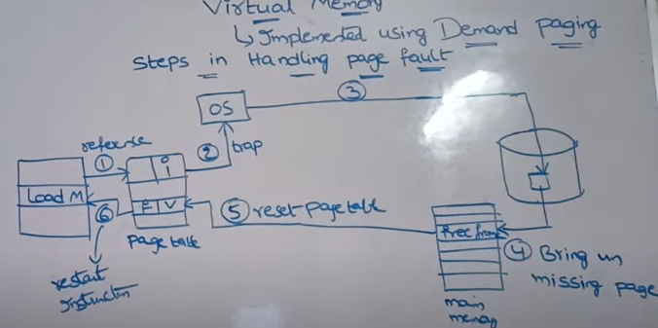
Page Fault Handling in VM

Slide 91
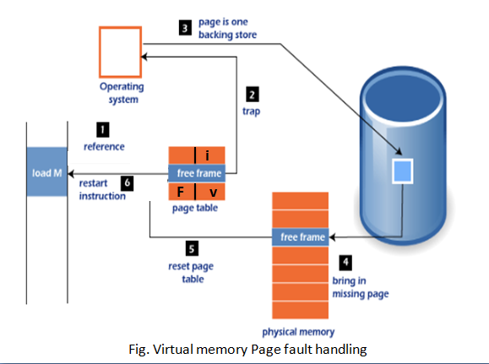

Slide 92
virtual memory management system
Let us assume 2 processes, P1 and P2, contains 4 pages each.
Each page size is 1 KB.
The main memory contains 8 frame of 1 KB each.
The OS resides in the first two partitions.
In the third partition, 1st page of P1 is stored
and the other frames are also shown as filled with the different pages of processes in the main memory.

Slide 93
virtual memory management system
The page tables of both the pages are 1 KB size each and
therefore they can be fit in one frame each.
The page tables of both the processes contain various information about processes.
The CPU contains a register which contains the base address of page table that is 5 in the case of P1 and 7 in the case of P2.

Slide 94
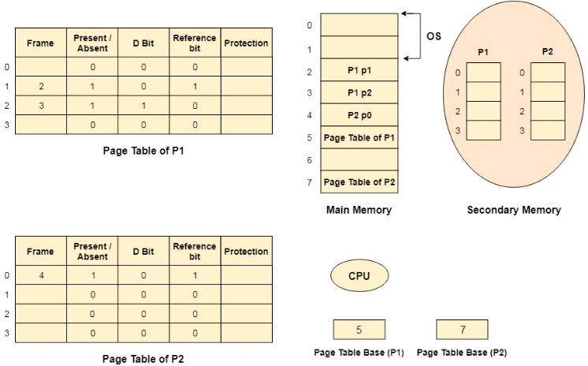
Fig. snapshot of Virtual Memory management

Slide 95
Advantages of Virtual Memory
The degree of Multiprogramming will be increased.
User can run large application with less real RAM.
There is no need to buy more memory RAMs.
Disadvantages of Virtual Memory
The system becomes slower since swapping takes time.
It takes more time in switching between applications.
The user will have the lesser hard disk space for its use.

Slide 96

Page Replacement Algorithms in Operating Systems
The important jobs of virtual memory in Operating Systems are two:
Frame Allocation
Page Replacement.

Slide 97
Frame Allocation in Virtual Memory
Demand paging is used to implement virtual memory, an essential component of operating systems.
A page-replacement mechanism and a frame allocation algorithm must be created for demand paging.
If you have numerous processes, frame allocation techniques are utilized to determine how many frames to provide to each process.

Slide 98
Frame Allocation Constraints
The Frames that can be allocated cannot be greater than total number of frames.
Each process should be given a set minimum amount of frames.
When fewer frames are allocated then the page fault ration increases and the process execution becomes less efficient.
There must be sufficient frames to accommodate all the many pages that a single instruction may refer to.

Slide 99
Frame Allocation Algorithms
There are three types of Frame Allocation Algorithms in Operating Systems:
1) Equal Frame Allocation Algorithms
2) Proportionate Frame Allocation Algorithms
3) Priority Frame Allocation Algorithms

Slide 100
Frame Allocation Algorithms
1) Equal Frame Allocation Algorithms:
Here, in this Frame Allocation Algorithm we take number of frames and number of processes at once.
We divide the number of frames by number of processes.
We get the number of frames we must provide for each process.
For ex: if we have 36 frames and 6 processes.
For each process 6 frames are allocated.
It is not very logical to assign equal frames to all processes in systems with processes of different sizes.
A lot of allocated but unused frames will eventually be wasted if a lot of frames are given to a little operation.

Slide 101
Frame Allocation Algorithms
2) Proportionate Frame Allocation Algorithms:
in this Frame Allocation Algorithms ,the number of frames based on the process size.
For big process more number of frames is allocated.
For small processes less number of frames is allocated by the operating system.
The problem in the Proportionate Frame Allocation Algorithm is number of frames are wasted in some rare cases.
The advantage in Proportionate Frame Allocation Algorithm is that instead of equally, each operation divides the available frames according to its demands

Slide 102
Frame Allocation Algorithms
3) Priority Frame Allocation Algorithms :
According to the quantity of frame allocations and the processes, priority frame allocation distributes frames.
a process has a high priority and needs more frames; in such case, additional frames will be given to the process.
Processes with lower priorities are then later executed in future and first only high priority processes are executed first.

Slide 103
Page Replacement Algorithms

Slide 104
Page Replacement Algorithms
Page replacement algorithms are used in virtual memory management
to decide which page to remove from memory when a new page needs to be loaded, and there is no available space.
There are three types of Page Replacement Algorithms. They are:
Optimal Page Replacement Algorithm
First In First Out Page Replacement Algorithm
Least Recently Used (LRU) Page Replacement Algorithm

Slide 105
Page Replacement Algorithms:
Need:
Limited Physical Memory (RAM) :
Processes may demand more memory than the system's available RAM.
To handle this, the OS uses virtual memory, which includes both RAM and disk space.
When the available RAM is full, some pages must be swapped out to disk to make space for new pages that the process needs.
The decision on which pages to remove is handled by page replacement algorithms.

Slide 106
Page Replacement Algorithms:
Need:
2) Handling Page Faults :
When a process requests a page that is not in physical memory, a page fault occurs.
The OS needs to load the requested page from disk. If there is no available space in memory, a page must be replaced (removed) to make room.

Slide 107
Page Replacement Algorithms:
Need:
3) Efficient Memory Utilization:
Multiprogramming: In modern operating systems, multiple processes run simultaneously.
Page replacement allows the system to keep the most needed pages in memory, improving performance.

Slide 108
First in First out Page Replacement Algorithm
In FIFO, the operating system maintains the order in which pages were loaded into memory,
and if memory is full, a page needs to be replaced
the oldest page (the one that has been in memory the longest) is swapped out.

Slide 109
First in First out Page Replacement Algorithm
Steps of FIFO Page Replacement:
Page Load: When a new page is requested and there’s space in memory, it is loaded into memory and placed in the queue.
Memory Full: Once the memory (frame buffer) is full, and a new page is needed, the page at the front of the queue (the oldest page) is swapped out.
Page Replacement

Slide 110
First in First out Page Replacement Algorithm
If the page to be searched is found among the frames then, this process is known as Page Hit.
If the page to be searched is not found among the frames then, this process is known as Page Fault(Page Miss).

Slide 111
Example:
Consider the reference string :
7,0,1,2,0,3,0,4,2,3,0,3,1,2,0
for a memory with three frames (F1,F2,& F3) and calculate number of
page faults ,
page hits,
hit ratio and
miss ratio
by using FIFO (First In First Out) Page replacement algorithms.

Slide 112
Answer:
Page Not Found - - - > Page Fault
Page Found - - - > Page Hit
H: Hit and F: Fault/Miss
Reference String : 7,0,1,2,0,3,0,4,2,3,0,3,1,2,0
F3
1
1
1
1
0
0
0
3
3
3
3
2
2
F2
0
0
0
0
3
3
3
2
2
2
2
1
1
1
F1
7
7
7
2
2
2
2
4
4
4
0
0
0
0
0
H/F
F
F
F
F
H
F
F
F
F
F
F
H
F
F
H
Reference String
7,
0,
1,
2,
0,
3,
0,
4,
2,
3,
0,
3,
1,
2,
0
No. of Page Fault =12 , No. of Hits= 3 ,hit to fault ratio = 3:12 = 1: 4
Fault % = fault/Ref.*100 = 12/15*100 = 80%
Hit % = hits/ref.*100 = 3/15*100 = 20%

Slide 113

Example 2
Page Not Found - - - > Page Fault
Page Found - - - > Page Hit

Slide 114

Example3 :
Belady's Anomaly in FIFO page Replacement: Balady found that, In FIFO page replacement algorithm, the number of page faults will get increased with the increment in number of frames.

Slide 115
Example4 :
Belady's Anomaly in FIFO page Replacement:
Reference String:
0 1 5 3 0 1 4 0 1 5 3 4

Slide 116



Slide 117
Optimal Page Replacement algorithm
The Optimal Page Replacement Algorithm is considered the best page replacement strategy in theory because it replaces the page that will not be needed for the longest period in the future.
However, it is difficult to implement in real-world systems because the OS cannot predict future page requests.

Slide 118
How Optimal Page Replacement Works:
The algorithm looks ahead to see which pages will be needed and
replaces the page that won't be used for the longest period in the future.
Since real operating systems can’t predict future memory references,
the Optimal algorithm is used mainly for benchmarking purposes rather than in practice
benchmarking means that the algorithm is used as a standard or reference to measure how well other page replacement algorithms perform.

Slide 119
Steps of the Optimal Page Replacement Algorithm:
When a page fault occurs (i.e., the requested page is not in memory), and memory is full, the OS identifies which pages are currently loaded in memory.
It checks the future references in the page reference string.
It replaces the page that is not used for the longest time in the future.

Slide 120
Example
reference string: 7 0 1 2 0 3 0 4 2 3
F3
-
-
1
1
1
3
3
3
3
3
F2
-
0
0
0
0
0
0
4
4
4
F1
7
7
7
2
2
2
2
2
2
2
H/F
F
F
F
F
H
F
H
F
H
H
7
0
1
2
0
3
0
4
2
3
Check for which page can replaced ? 7 will not used in future ,so replaced it
No. of Page Fault =6 , No. of Hits=4
2) Check for which page can replaced ? 1 will not used in future ,so replaced it
2) Check for which page can replaced ? 0 will not used in future ,so replaced it

Slide 121

Example 2:
Consider the reference string 6, 1, 1, 2, 0, 3, 4, 6, 0, 2, 1, 2, 1, 2, 0, 3, 2, 1, 4, 0 for a memory with three frames and calculate number of page faults by using OPTIMAL Page replacement algorithms.

Slide 122
Least Recently Used (LRU) Replacement Algorithm
Replace the page that has been used the least recently in the past.
The LRU algorithm remove the page that has not been used for the longest time.
Advantages of LRU:
Predictive: LRU provides good performance because it uses past behavior (recent page access patterns) to make decisions about which pages to replace.
Reduces Page Faults: It minimizes the number of page faults compared to other simple algorithms like FIFO.

Slide 123
Example
reference string: 7 0 1 2 0 3 0 4 2 3
F3
-
-
1
1
1
3
3
3
2
2
F2
-
0
0
0
0
0
0
0
0
3
F1
7
7
7
2
2
2
2
4
4
4
H/F
F
F
F
F
H
F
H
F
F
F
7
0
1
2
0
3
0
4
2
3
Check for which page can replaced ? 7 is least recently used in past ,so replaced it
No. of Page Fault =8 , No. of Hits=2
2) Check for which page can replaced ? 1 is least recently used in past, so replaced it
3) Check for which page can replaced ? 2 is least recently used in past, so replaced it
5) Check for which page can replaced ? 0 is least recently used in past, so replaced it
4) Check for which page can replaced ? 3 is least recently used in past, so replaced it

Slide 124

Example 2
reference string 6, 1, 1, 2, 0, 3, 4, 6, 0, 2, 1, 2, 1, 2, 0, 3, 2, 1, 2, 0

Slide 125
Q. Consider a reference string: 4, 7, 6, 1, 7, 6, 1, 2, 7, 2. the number of frames in the memory is 3. Find out the number of page faults respective to:
Optimal Page Replacement Algorithm
FIFO Page Replacement Algorithm
LRU Page Replacement Algorithm

Slide 126


Slide 127


Slide 128


